Slide 1

SQL JOINS
PRAMOD

Slide 2
What is JOINS
A JOIN clause is used to combine rows from two or more tables, based on a related column between them.

Slide 3
Different Types of SQL JOINs
Here are the different types of the JOINs in SQL:
01
(INNER) JOIN: Returns records that have matching values in both tables
02
LEFT (OUTER) JOIN: Returns all records from the left table, and the matched records from the right table
03
RIGHT (OUTER) JOIN: Returns all records from the right table, and the matched records from the left table
04
FULL (OUTER) JOIN: Returns all records when there is a match in either left or right table
05

Slide 4
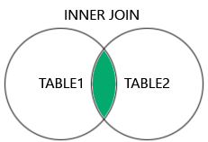
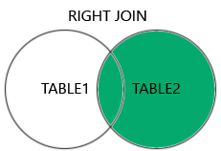
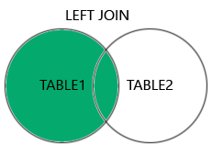
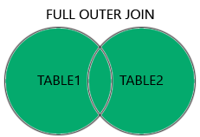

Slide 5
INNER JOIN
The INNER JOIN keyword selects records that have matching values in both tables.
Example:-
SELECT Orders.OrderID, Customers.CustomerName, Orders.OrderDate FROM Orders INNER JOIN Customers ON Orders.CustomerID=Customers.CustomerID;

Slide 6
LEFT JOIN
From the left table (table1), and the matching records from the right table (table2). The result is 0 records from the right side, if there is no match.
Example-
SELECT Customers.CustomerName, Orders.OrderID FROM Customers LEFT JOIN Orders ON Customers.CustomerID = Orders.CustomerID ORDER BY Customers.CustomerName;

Slide 7
RIGHT JOIN
The RIGHT JOIN keyword returns all records from the right table (table2), and the matching records from the left table (table1). The result is 0 records from the left side, if there is no match.
Example-
SELECT Orders.OrderID, Employees.LastName, Employees.FirstName FROM Orders RIGHT JOIN Employees ON Orders.EmployeeID = Employees.EmployeeID ORDER BY Orders.OrderID

Slide 8
FULL OUTER JOIN
The FULL OUTER JOIN keyword returns all records when there is a match in left (table1) or right (table2) table records.
Tip: FULL OUTER JOIN and FULL JOIN are the same.
Example-
SELECT Customers.CustomerName, Orders.OrderID FROM Customers FULL OUTER JOIN Orders ON Customers.CustomerID=Orders.CustomerID ORDER BY Customers.CustomerName;

Slide 9

Thank You

